Slide 1
Neural Network and Deep Learning 23CS8PENDL/23CS7PENDL

Slide 2
Unit-2
Multilayer Perceptron: Introduction, Batch Learning and on-line Learning, The Back- Propagation Algorithm, The Hessian and its Role in On-Line Learning, Generalization, Approximation of Functions, Cross-Validation, Complexity Regularization and Network Pruning, Supervised Learning viewed as an Optimization, Non-Linear Filtering

Slide 3
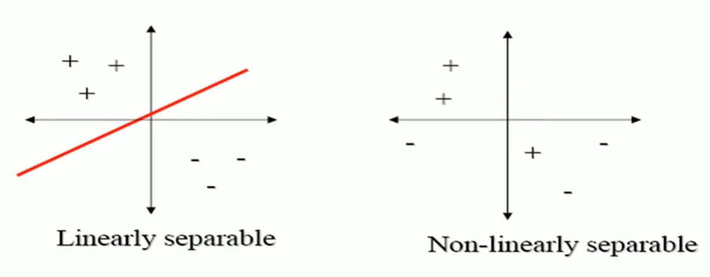
Linear Neurons and Limitations
The perceptron can only model linearly separable functions, − those functions which can be drawn in 2-dim graph and single straight line separates values in two part.
Boolean functions given below are linearly separable: − AND − OR − COMPLEMENT
It cannot model XOR function as it is non linearly separable. − When the two classes are not linearly separable, it may be desirable to obtain a linear separator that minimizes the mean squared error.

Slide 4
XOR – Non linearly separable function
A typical example of non-linearly separable function is the XOR that computes the logical exclusive or..
This function takes two input arguments with values in {0,1} and returns one output in {0,1},
Here 0 and 1 are encoding of the truth values false and true,
The output is true if and only if the two inputs have different truth values.
XOR is non linearly separable function which can not be modeled by perceptron.
For such functions we have to use multilayer perceptron.

Slide 5
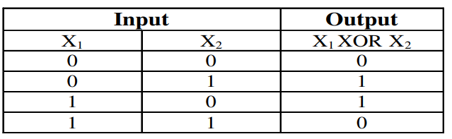
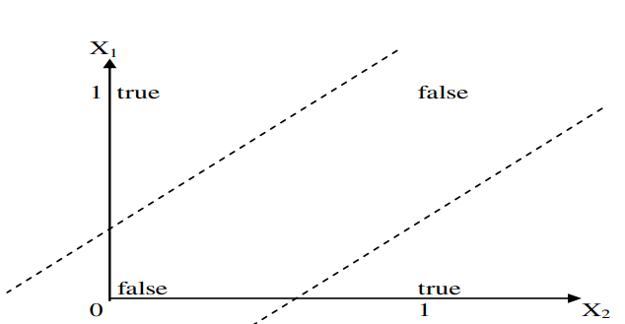
XOR – Non linearly separable function
These two classes (true and false) cannot be separated using a line. Hence XOR is non linearly separable.

Slide 6
Multilayer Perceptron
To overcome the practical limitations of the perceptron and the LMS algorithm, we look to a neural network structure known as the multilayer perceptron.
The following three points highlight the basic features of multilayer perceptrons:
• The model of each neuron in the network includes a nonlinear activation function that is differentiable.
• The network contains one or more layers that are hidden from both the input and output nodes.
• The network exhibits a high degree of connectivity, the extent of which is determined by synaptic weights of the network.

Slide 7
Question: Multilayer Perceptron
Explain the three basic features of the multilayer perceptron and the two phases of training by back-propagation algorithm with LMS as a special case.

Slide 8
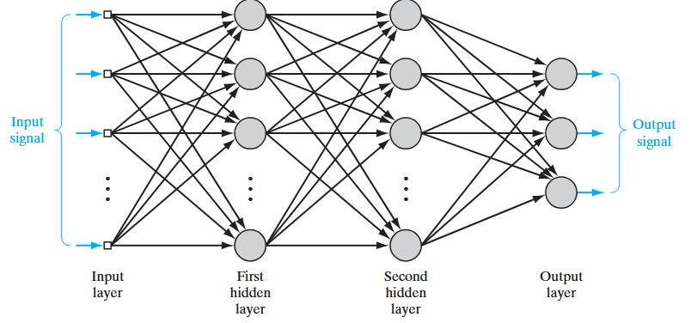
Architectural graph of a multilayer perceptron
Architectural graph of a multilayer perceptron with two hidden layers
Notes:
To set the stage for a description of the multilayer percep-tron in its general form, the network shown here is fully connected. This means that a neu-
ron in any layer of the network is connected to all the neurons (nodes) in the previous layer. Signal flow through the network progresses in a forward direction, from left to right
and on a layer-by-layer basis.

Slide 9
Architectural graph of a multilayer perceptron (MLP)
A multilayer perceptron (MLP) is a perceptron that teams up with additional perceptron stacked in several layers, to solve complex problems.
Each perceptron sends multiple signals, one signal going to each perceptron in the next layer.
For each signal, the perceptron uses different weights.
The multilayer perceptron has another, more common name—a neural network.
• A three-layer MLP is called a Non-Deep or Shallow Neural Network.
• An MLP with four or more layers is called a Deep Neural Network.
Classic Perceptron Vs. A Neural Network:
• In a classic perceptron, the decision function is a step function and the output is binary.
• In neural networks that evolved from MLPs, other activation functions can be used, usually between 0 and 1 or between -1 and 1.
• This allows for probability-based predictions or classification of items into multiple labels.
A Multilayer Perceptron (MLP) is a feedforward artificial neural network consisting of multiple layers of interconnected neurons.
Input Layer: Each neuron or node in this layer corresponds to an input feature. For instance, if you have three input features the input layer will have three neurons.
Hidden Layers: MLP can have any number of hidden layers with each layer containing any number of nodes. These layers process the information received from the input layer.
Output Layer: The output layer generates the final prediction or result. If there are multiple outputs, the output layer will have a corresponding number of neurons.
A binary classification problem may have a single output neuron and use a sigmoid activation function to output a value between 0 and 1
A multi-class classification problem may have multiple neurons in the output layer, one for each class

Slide 10
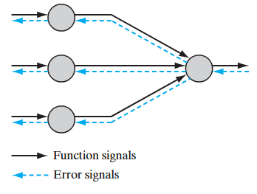
Multilayer Perceptron: Two kinds of Signal
Two kinds of signals are identified in Multilayer Perceptron network:
1. Function Signals. A function signal is an input signal (stimulus) that comes in at the input end of the network, propagates forward (neuron by neuron) through the network, and emerges at the output end of the network as an output signal. We refer to such a signal as a “function signal” for two reasons. First, it is presumed to perform a useful function at the output of the network. Second, at each neuron of the network through which a function signal passes, the signal is calculated as a
function of the inputs and associated weights applied to that neuron. The function signal is also referred to as the input signal.
2. Error Signals. An error signal originates at an output neuron of the network and propagates backward (layer by layer) through the network. We refer to it as an “error signal” because its computation by every neuron of the network involves an error-dependent function in one form or another

Slide 11
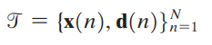
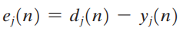
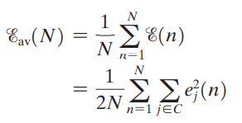
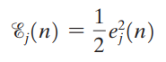
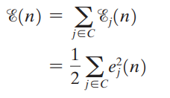
Batch learning and Online Learning: Background Information
Consider a multilayer perceptron with an input layer of source nodes, one or more hidden layers, and an output layer consisting of one or more neurons
Training Samples:
Let yj (n) denote the function signal produced at
the output of neuron j in the output layer by the
stimulus x(n) applied to the input layer.
Correspondingly, the error signal produced
at the output of neuron j is defined by
where dj (n) is the ith element of the desired-response vector d(n)
With the training sample consisting
of N examples, the error energy
averaged over the training sample,
is defined by
Summing the error-energy contributions of
all the neurons in the output layer,
we express the total instantaneous error
energy of the whole network as
Instantaneous error energy
of neuron j is defined by
set C includes all
the neurons in the
output layer.

Slide 12
Batch learning: How weights are updated
In the batch method of supervised learning, adjustments to the synaptic weights of the multilayer perceptron are performed after the presentation of all the N examples in the training sample t that constitute one epoch of training.
In other words, the cost function for batch learning is defined by the average error energy E_{av}. Adjustments to the synaptic weights of the multilayer perceptron are made on an epoch-by-epoch basis.

Slide 13
Batch learning: Advantages and Disadvantages
Advantages: With the method of gradient descent used to perform the training, the advantages of batch learning include the following:
• Accurate estimation of the gradient vector (i.e., the derivative of the cost function E_{av} with respect to the weight vector w), thereby guaranteeing, under simple conditions, convergence of the method of steepest descent to a local minimum;
• parallelization of the learning process.
Disadvantages:
However, from a practical perspective, batch learning is rather demanding in terms of storage requirements

Slide 14
Online learning: How weights are updated
In the on-line method of supervised learning, adjustments to the synaptic weights of the multilayer perceptron are performed on an example-by-example basis.The cost function to be minimized is therefore the total instantaneous error energy e(n).
Consider an epoch of N training examples arranged in the order {x(1), d(1)}, {x(2), d(2)}, {x(N), d(N)}.The first example pair {x(1), d(1)} in the epoch is presented to the network, and the weight adjustments are performed using the method of gradient descent.
Then the second example {x(2), d(2)} in the epoch is presented to the network, which leads to further adjustments to weights in the network. This procedure is continued until the last example {x(N), d(N)} is accounted for.

Slide 15
Online learning: Advantages and Disadvantages
Advantage:
On-line learning is the fact that it requires much less storage than batch learning.
Given that the training examples are presented to the network in a random manner, the use of on-line learning makes the search in the multidimensional weight space stochastic in nature; it is for this reason that the method of on-line learning is sometimes referred to as a stochastic method. This stochasticity has the desirable effect of making it less likely for the learning process to be trapped in a local minimum.
On-line learning is popular for solving pattern-classification problems because it is simple to implement.
Disadvantages:
Parallalization cannot be achieved in on-line learning.

Slide 16
Question: Batch and Online learning
Evaluate how batch and online learning impact convergence rate, generalization capability, and computational performance
How do batch learning and on-line learning differ in terms of synaptic weight adjustments in a multilayer perceptron, and what are the advantages associated with each method?

Slide 17
MLP or Neural Network: Training process
The neural network needs to be trained in order to work. Its training process is in the context of supervised machine learning, where each data sample has a label informing to which class it belongs to. Thus, the general idea is to make the network able to learn the patterns relative to each class of objects we have, so when a new unknown sample of data is given to the network, it will be able to predict to which class that sample belongs to. How can this be done?
The idea of the backpropagation algorithm is, based on error (or loss) calculation, to recalculate the weights array w in the last neuron layer, and proceed this way towards the previous layers, from back to front, that is, to update all the weights w in each layer, from the last one until reaching the input layer of the network, for this doing the backpropagation of the error obtained by the network. In other words, we calculate the error between what the network predicted to be and what it was indeed, then we recalculate all the weights values, from the last layer to the very first one, always intending to decrease the neural network error.

Slide 18
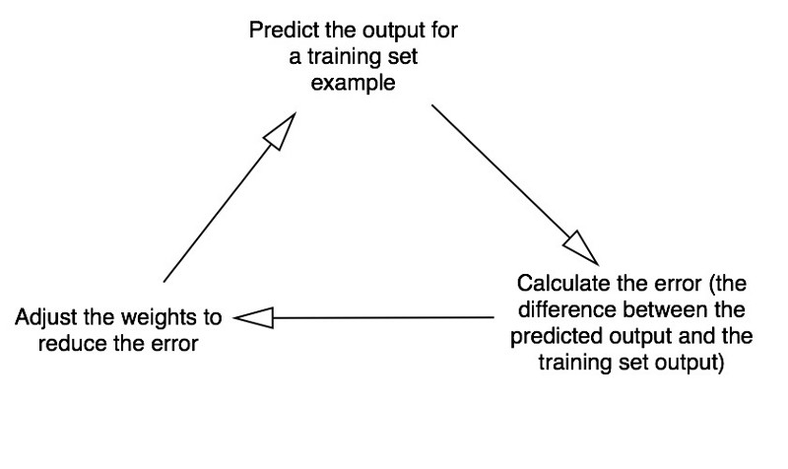
MLP or Neural Network: Training process
Forward Propagation
Backward Propagation

Slide 19
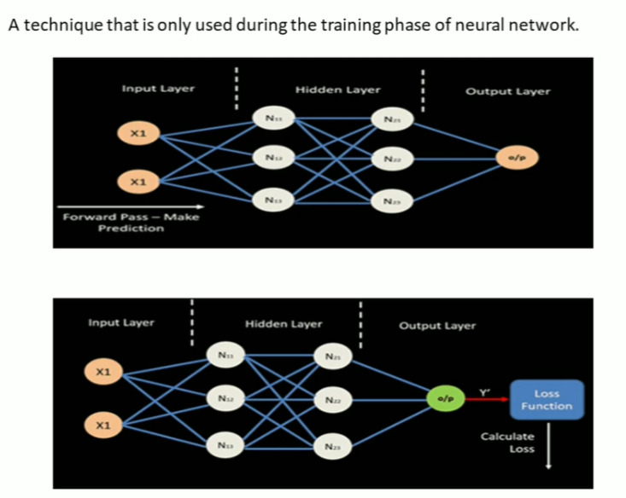
Backpropagation
Notes:
A technique that is only used during training phase of neural network.

Slide 20
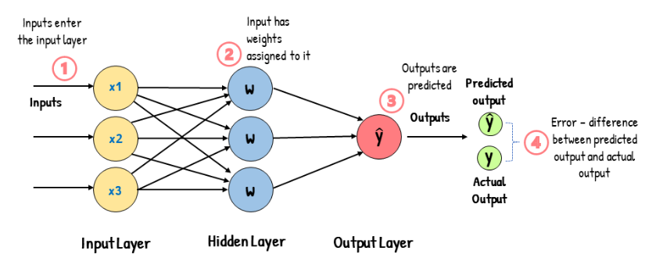
How Backpropagation works?
Backpropagation: A technique that is only used during training phase of neural network.

Slide 21
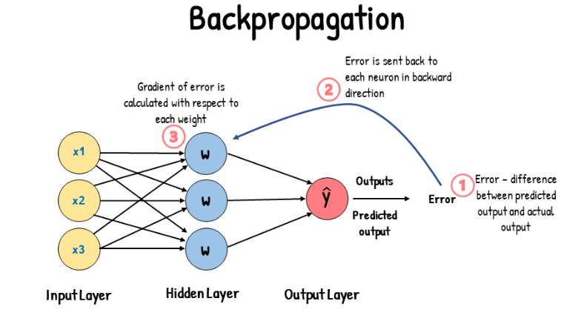

Slide 22
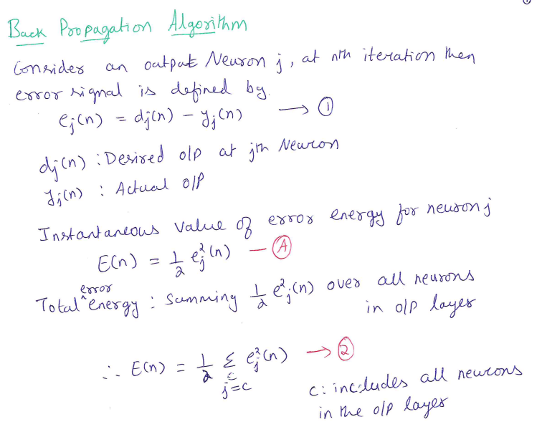

Slide 23
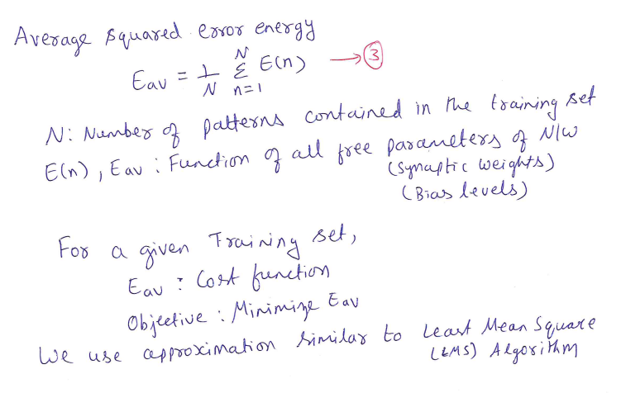
Back Propagation Algorithm

Slide 24
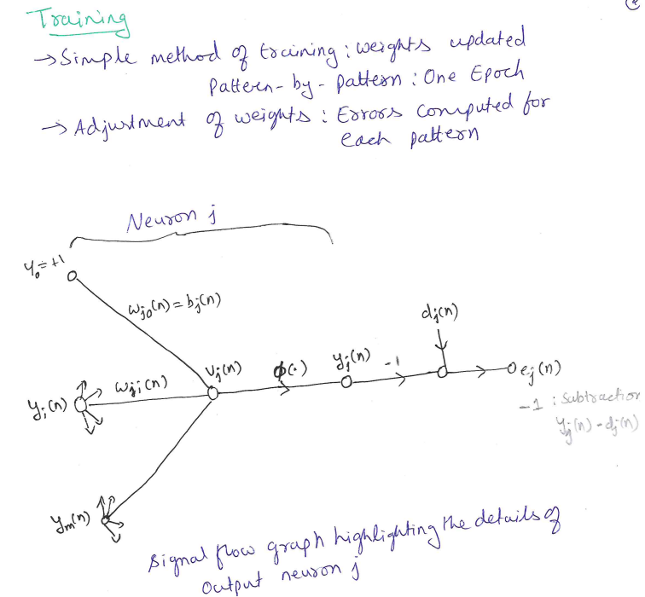
Back Propagation Algorithm

Slide 25
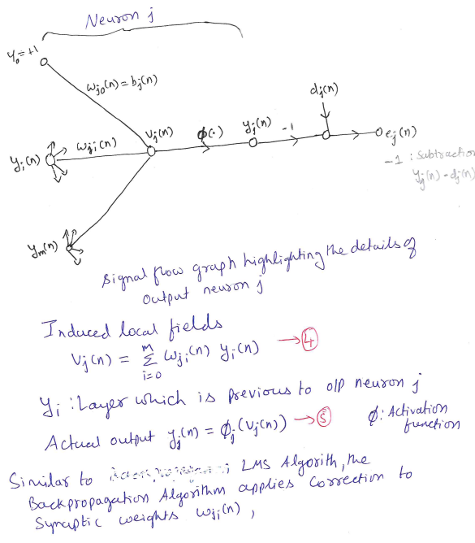
Back Propagation Algorithm

Slide 26
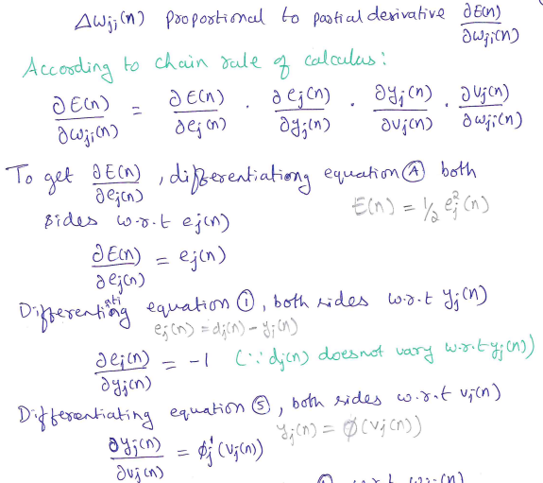
Back Propagation Algorithm

Slide 27
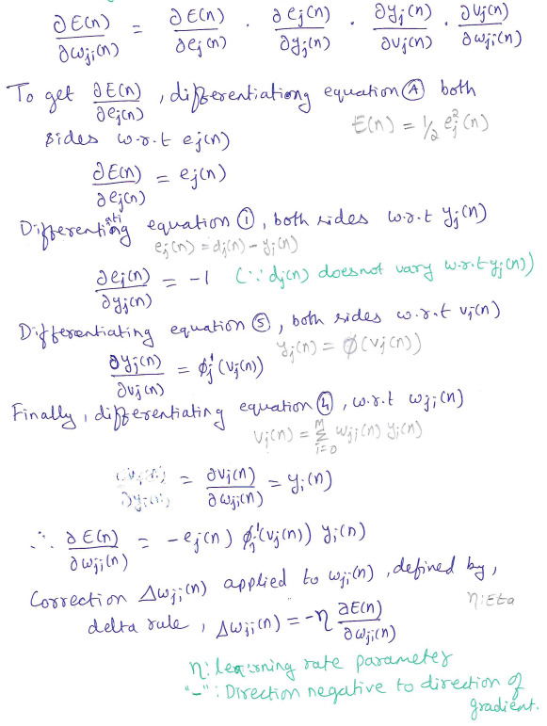
Back Propagation Algorithm

Slide 28
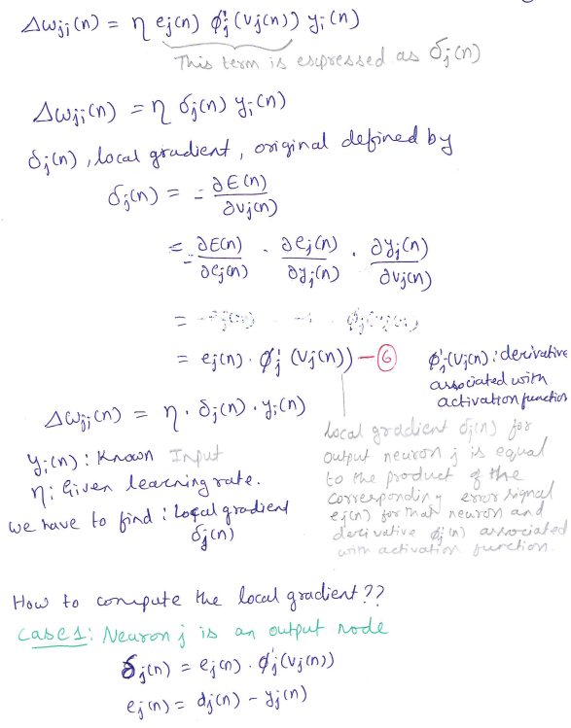
Back Propagation Algorithm

Slide 29
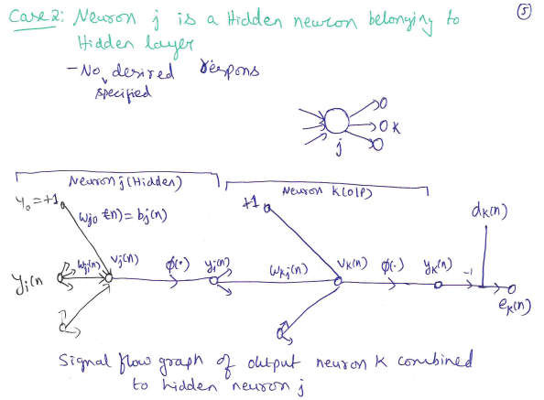
Back Propagation Algorithm

Slide 30
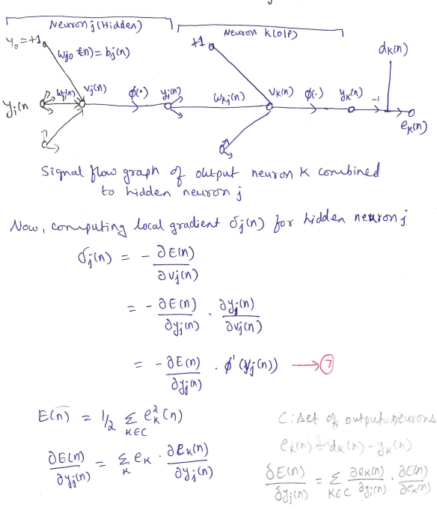
Back Propagation Algorithm

Slide 31
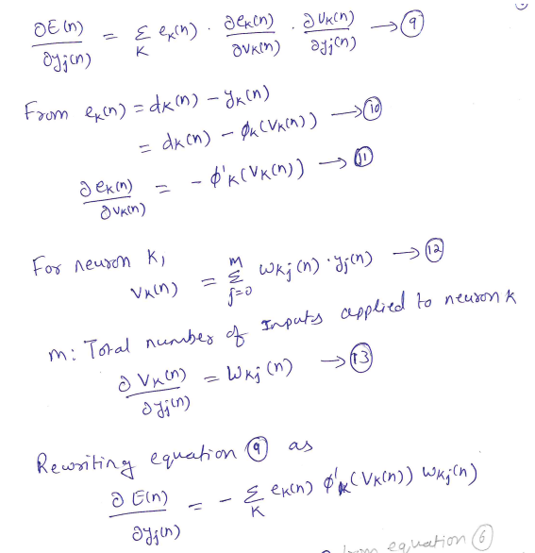
Back Propagation Algorithm

Slide 32
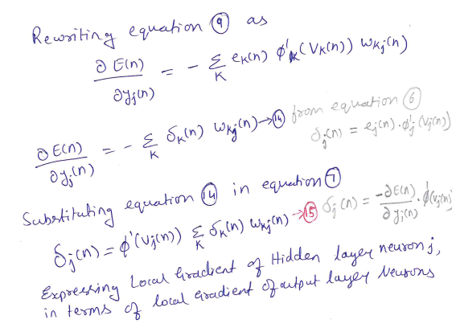
Back Propagation Algorithm

Slide 33
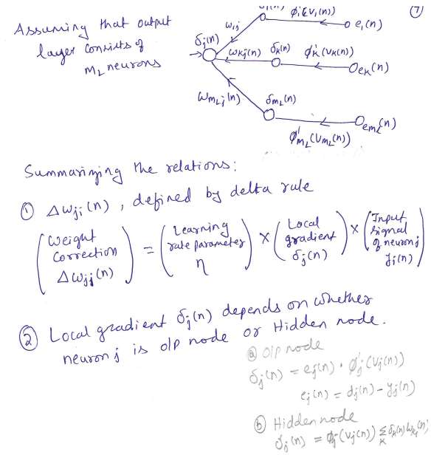
Back Propagation Algorithm

Slide 34
Question: Back Propagation algorithm
Derive the expression for the local gradient δj(n) used to change the synaptic weights in the backpropagation algorithm.
Derive the local gradient expressions for Neuron j as an output node and as a hidden node, detailing the differences in their calculations

Slide 35
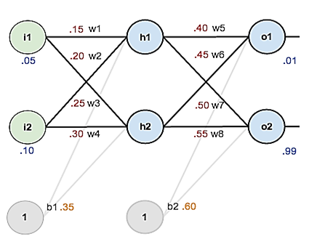
Question: Back Propagation algorithm
Consider the network given below apply the backpropagation algorithm to update the weights w1- w8 to obtain the output expected output with the learning rate 0.5. Use sigmoid activation function to train the network.
Neural Network: 2 inputs, 2 hidden neurons,
2 output Neurons

Slide 36
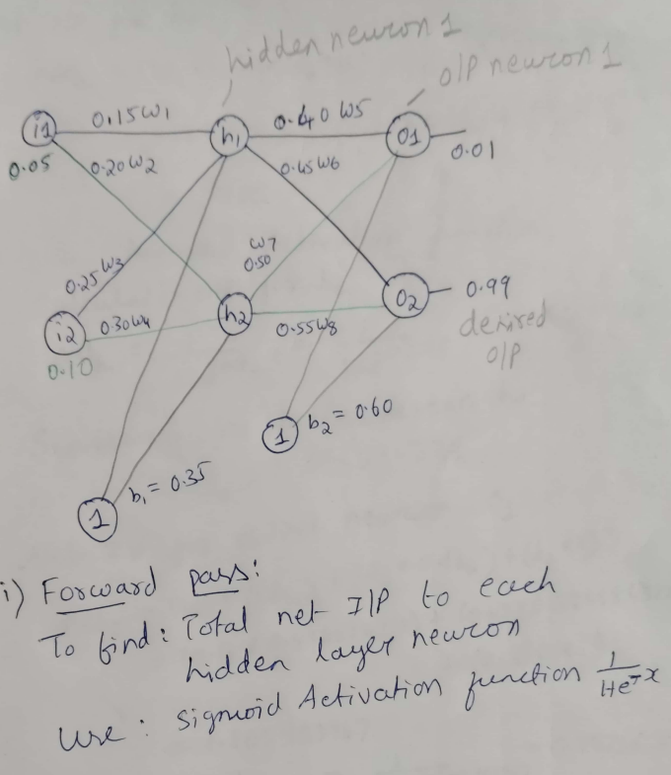
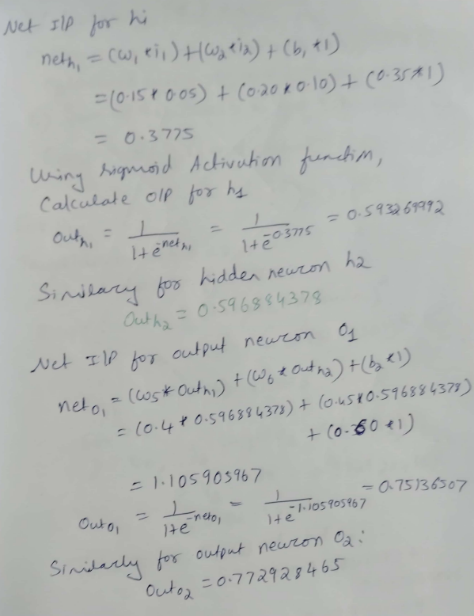

Slide 37
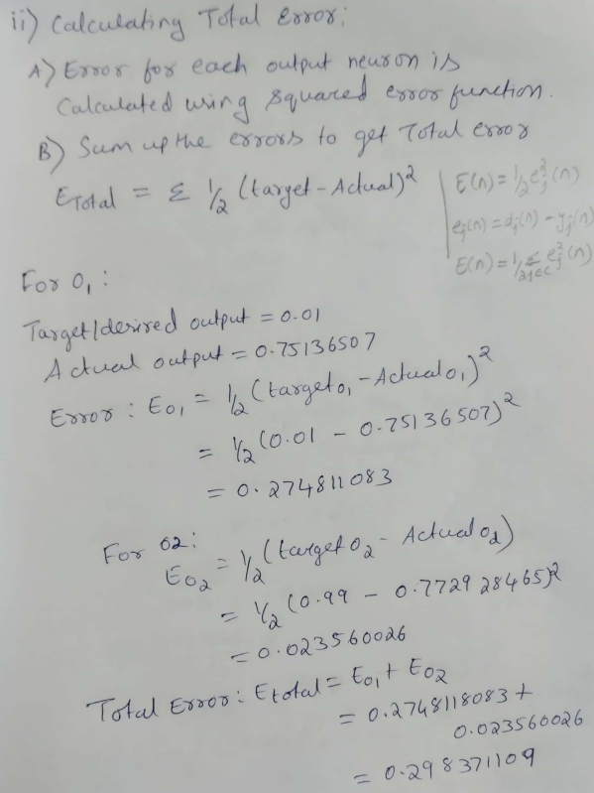
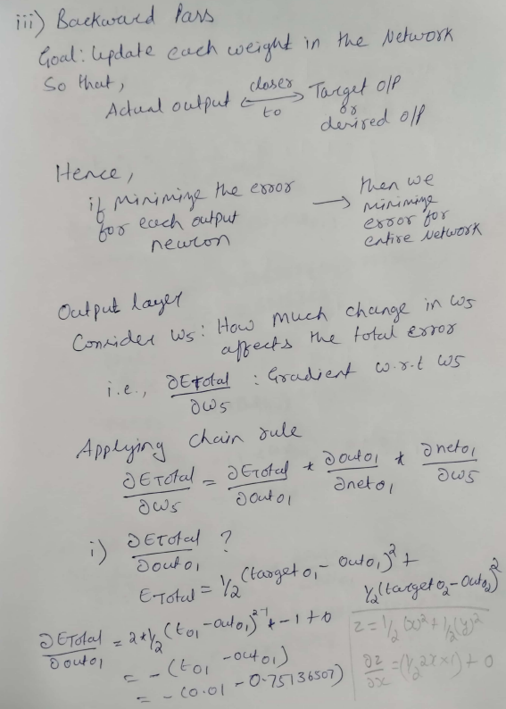

Slide 38
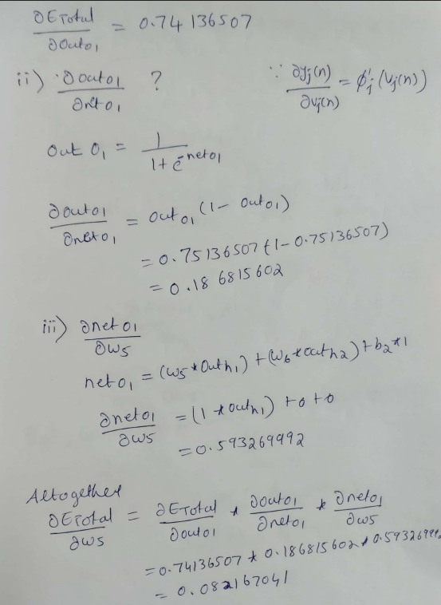
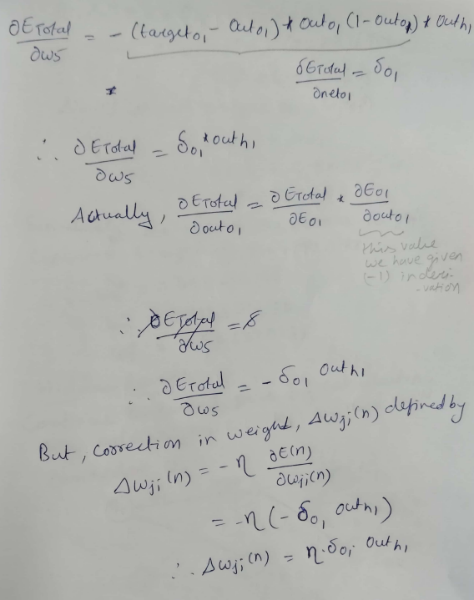

Slide 39
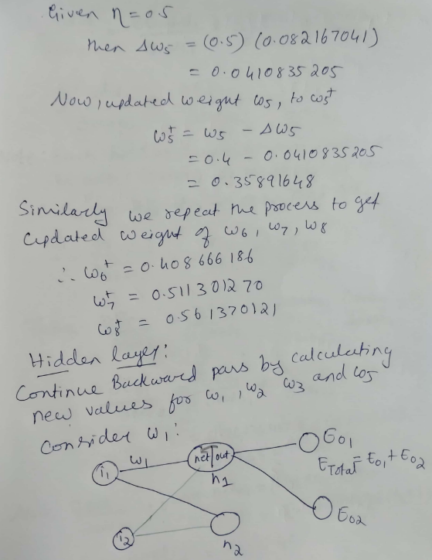
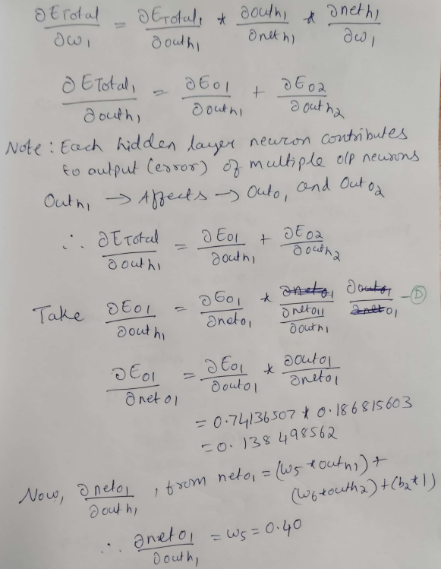

Slide 40
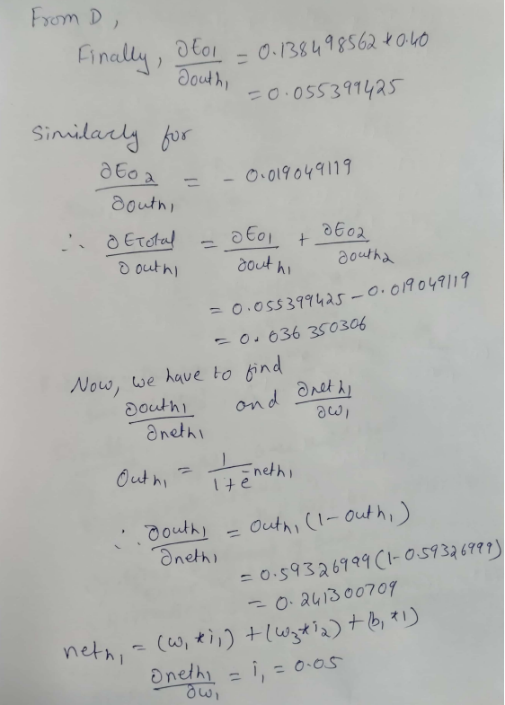
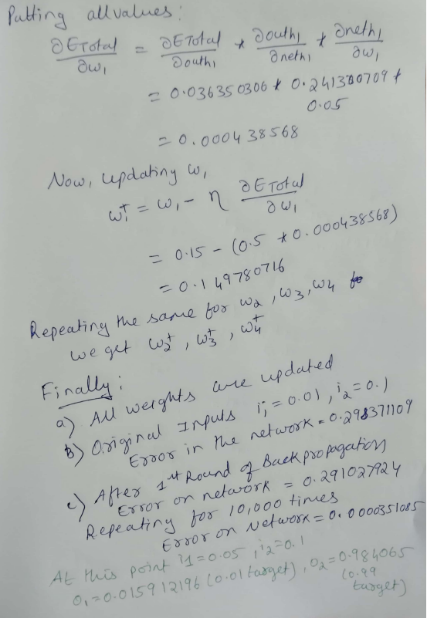

Slide 41
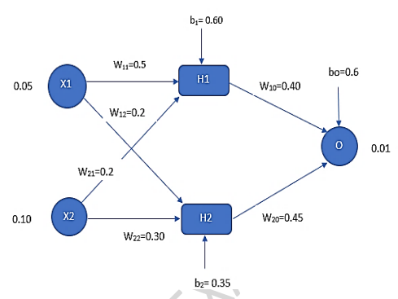
Question: Back Propagation algorithm
Consider a multilayer feed-forward neural network given below. Let the learning rate be 0.5. Assume initial values of weights and biases as given in the figure below. Show weight and bias updates by using back-propagation algorithm. Assume that sigmoid activation function is used in the network.

Slide 42
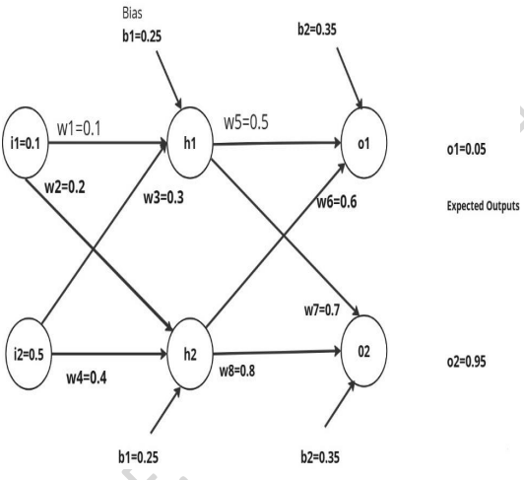
Question: Back Propagation algorithm
Apply the backpropagation algorithm for the network given below to update the weights w1- w8 to obtain the expected output with the learning rate 0.6. Use sigmoid activation function to train the network. In the network, i1, i2 are input layer neurons, h1 and h2 in hidden layer neurons and o1 and o2 are output layer neurons.

Slide 43
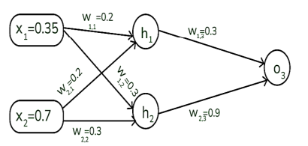
Question: Back Propagation algorithm
Assume that the neurons have the sigmoid activation function to perform forward and backward pass on the network. And also assume that the actual output of y is 0.5 and the learning rate is 1. Show weight updates by using back-propagation algorithm.

Slide 44
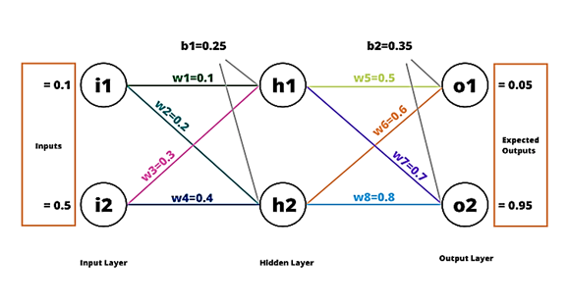
Question:Back Propagation algorithm
Consider the network given below apply the backpropagation algorithm to update the weights w1- w8 to obtain the output expected output with the learning rate 0.6. Use sigmoid activation function to train the network.

Slide 45
Hessian and its role in online learning

Slide 46
Why Do We Need the Hessian?
So far, in backpropagation learning, we have focused on:
First-order derivative → Gradient of the error surface
Used to decide the direction of weight update
However, we often observe that:
Learning is fast in some cases and very slow in others
Learning may oscillate or become unstable
Lower layers learn slowly compared to upper layers
These behaviors cannot be explained by gradients alone. To understand them, we must study the second-order structure of the error surface — the Hessian matrix.

Slide 47
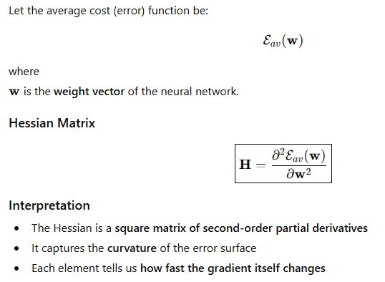
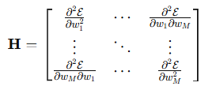
Definition of the Hessian Matrix
Gradient tells us where to go; Hessian tells us how the surface bends.

Slide 48
Role of the Hessian in Neural Network Learning
The Hessian plays an important role in neural networks, especially in:
Backpropagation learning dynamics
Stability of learning
Speed of convergence
The eigenstructure of the Hessian strongly influences learning behavior in backpropagation.

Slide 49
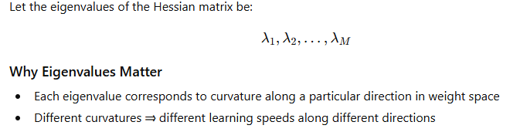
Eigenvalues of the Hessian

Slide 50
Typical Eigenvalue Composition in MLPs
For a multilayer perceptron trained using backpropagation, experiments show that the Hessian has:
a small number of small eigenvalues
a large number of medium-sized eigenvalues
a small number of large eigenvalues

Slide 51
Factors Affecting Hessian Eigenvalues
(i) Nonzero-Mean Input or Output Signals
If inputs or induced neural outputs have nonzero mean:
Hessian eigenvalue spread increases
Learning becomes slower and more unstable
Design Principle: Avoid nonzero-mean input signals whenever possible.
(ii) Correlation Between Inputs and Outputs
High correlation between input vector elements
High correlation between neuron outputs
Leads to: Ill-conditioned Hessian and Slow convergence
(iii)Layer-Wise Variations in Second-Order Derivatives
Second derivatives are:
Smaller in lower layers
Larger in higher layers
Important Insight
Weights in the first hidden layer learning slowly
Weights in the last layers learn faster
Notes:
x1x_1x1​ = temperature in Celsius
x2x_2x2​ = temperature in Fahrenheit
Relation:
x2=1.8x1+32x_2 = 1.8x_1 + 32x2​=1.8x1​+32 Why This Is Correlated
Both inputs represent the same physical quantity
When x1x_1x1​ increases, x2x_2x2​ also increases
One input can be predicted from the other
📌 Conclusion Inputs are highly correlated.
Correlated Input Example:
Temperature in °C and °F
Correlated Output Example:
Two hidden neurons learning the same feature
Correlated input: Inputs that carry redundant information, such as temperature in Celsius and Fahrenheit.
Correlated output: Hidden neurons producing similar activations due to similar weights or inputs.
“Do we learn faster if we repeat the same information twice?”
Then connect:
“Neural networks also learn slower with repeated (correlated) information.”

Slide 52
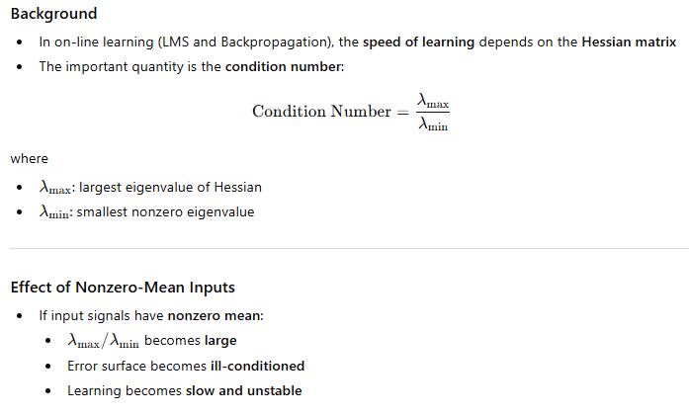
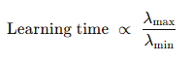
Avoidance of Nonzero-mean Inputs

Slide 53
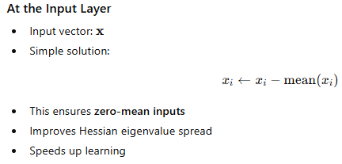
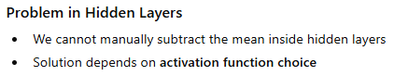
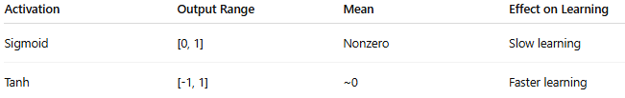
How to Avoid Nonzero-Mean Signals in Neural Networks
Zero-mean signals → better Hessian → faster learning
Nonzero-mean signals → poor Hessian → slow learning

Slide 54
Asymptotic Behavior of On-line Learning
Asymptotic behavior refers to:
The behavior of the learning process after a very large number of iterations (i.e., as n→∞)
In simple terms:
What happens to the weights after long training?
Do they converge?
Do they fluctuate?
How stable is the learning?
In on-line learning:
Network weights are updated one sample at a time
Learning is stochastic (contains randomness)
Error does not decrease smoothly
To understand such learning, we study how the average learning curve behaves over a long period of time.

Slide 55
Asymptotic Behavior of On-line Learning
In on-line learning, weights are updated one sample at a time, so learning is stochastic. Because of this randomness, even after a very long time, the weights do not settle exactly at the minimum — they fluctuate around it.
“This long-term behavior of weights is what we call asymptotic behavior.”
“If the weights are fluctuating, what controls how large these fluctuations are?”
The answer is — the learning rate.

Slide 56
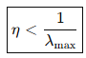

Asymptotic Behavior of On-line Learning
To ensure stable learning, the learning rate must satisfy:
where: λ_{max}​ = largest eigenvalue of the Hessian
If η is too large:
Learning becomes unstable
Weights may diverge

Slide 57
Question: Hessian and its role in online learning
What is the role of the Hessian in study of neural networks, how does avoiding nonzero-mean inputs impact the learning process, and what is the importance of asymptotic behavior of assuming a fixed learning-rate parameter?

Slide 58
Generalization

Slide 59
Generalization
In back-propagation learning, we typically start with a training sample and use the backpropagation algorithm to compute the synaptic weights of a multilayer perceptron by loading as many of the training examples as possible into the network. The hope is that the neural network so designed will generalize well.
A network is said to generalize well when the input–output mapping computed by the network is correct for test data.
The learning process (i.e., training of a neural network) may be viewed as a “curvefitting” problem. The network itself may be considered simply as a nonlinear input–output mapping.
Such a viewpoint then permits us to look at generalization not as a mystical property of neural networks, but rather simply as the effect of a nonlinear interpolation of the input data.
Nonlinear interpolation is the process of estimating unknown data points within a known range by fitting a nonlinear function to the existing data, such that the interpolated points form a curve rather than a straight line.

Slide 60


Generalization
Figure illustrates how generalization may occur in a hypothetical network. The nonlinear input–output mapping represented by the curve depicted in this figure is computed by the network as a result of learning the points labeled as “training data.” The point marked in blue on the curve as “generalization” is thus seen as the result of interpolation performed by the network.
When, however, a neural network learns too many input–output examples, the network may end up memorizing the training data. It may do so by finding a feature (due to noise, for example) that is present in the training data, but not true of the underlying function that is to be modeled. Such a phenomenon is referred to as overfitting or overtraining. When the network is overtrained, it loses the ability to generalize between similar input–output patterns.
Properly fitted nonlinear mapping with good generalization. (b) Overfitted nonlinear mapping with poor generalization.

Slide 61
Unit-2
Multilayer Perceptron: Introduction, Batch Learning and on-line Learning, The Back- Propagation Algorithm, The Hessian and its Role in On-Line Learning, Generalization, Approximation of Functions, Cross-Validation, Complexity Regularization and Network Pruning, Supervised Learning viewed as an Optimization, Non-Linear Filtering

Slide 62
Question: Approximation functions
Derive an expression for the Universal approximation theorem for a nonlinear input -output mapping.

Slide 63
Question: Cross Validation
Write the algorithm for stratified k-Fold cross-validation

Slide 64
Question: Supervised Learning viewed as an Optimization
Derive the steps in applying the Conjugate Gradient Method and Quasi Newton method for the supervised training of a multilayer perceptron.
How training differs from pure optimization ? Write the process to minimize the average training error.
Show that the supervised learning can be viewed as an optimization problem by summarizing the steps involved in the Nonlinear Conjugate gradient method and Quasi-Newton Method.

Slide 65
Question: Non-linear filtering
What is nonlinear filtering? Illustrate the two basic ways where time may be built into the operation of a neural network. With a neat block diagram, describe the cascade connection of two subsystems: short-term memory and a static neural network.

Slide 66
Analyze how time can be incorporated into the operation of a neural network to enable temporal pattern recognition and what are the two basic ways this can be achieved. With the block diagram of a discrete-time memory structure consisting of p identical sections connected in cascade, derive an equation for memory depth D.

Slide 67
Question: Multilayer Perceptron
Derive the steps in applying the Conjugate Gradient Method and Quasi Newton method for the supervised training of a multilayer perceptron.
Explain the three basic features of the multilayer perceptron and the two phases of training by back-propagation algorithm with LMS as a special case.

Slide 68
Thanks for Listening

